Slide 1
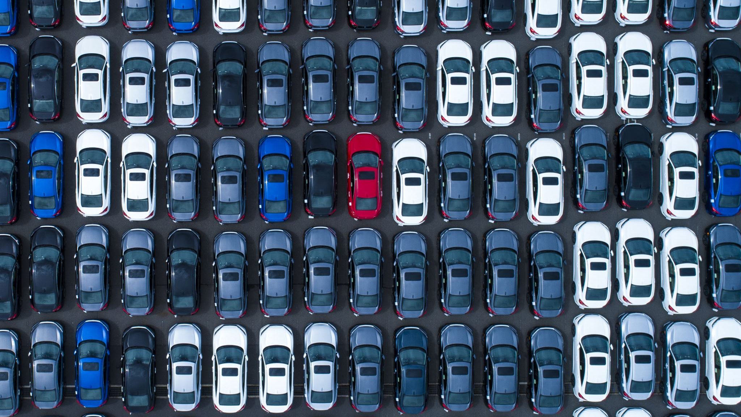
PREDICTION OF CAR PRICES BASED ON THEIR FEATURES

Slide 2
CONTENT
INTRODUCTION TO THE DATA SET
Methodology
CONCLUSION
Inferences

Slide 3
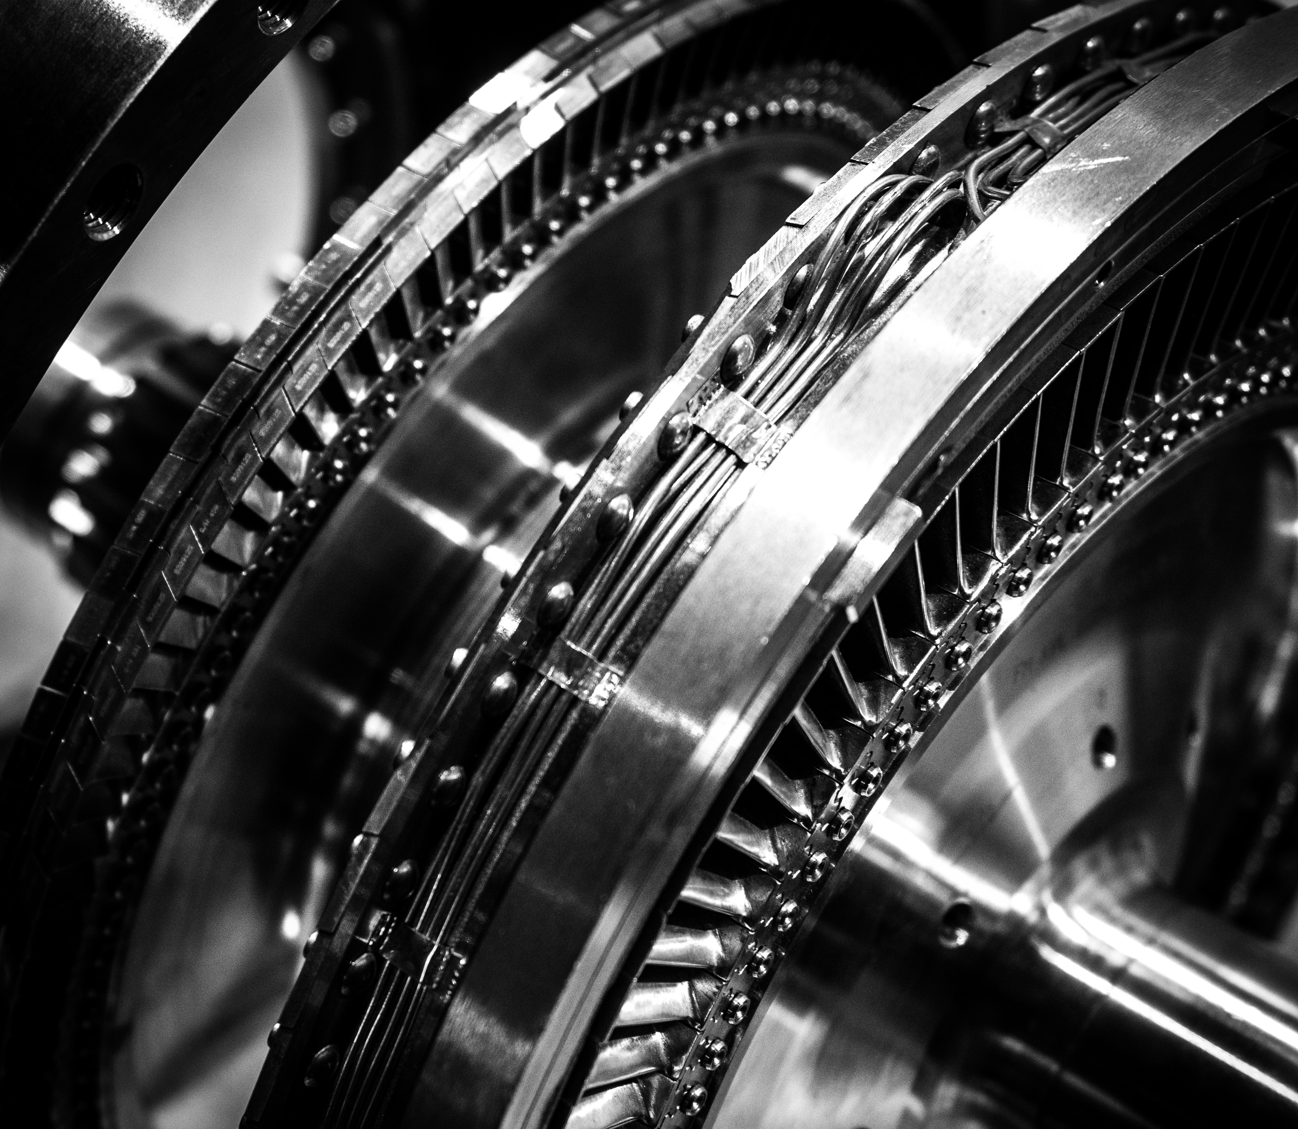


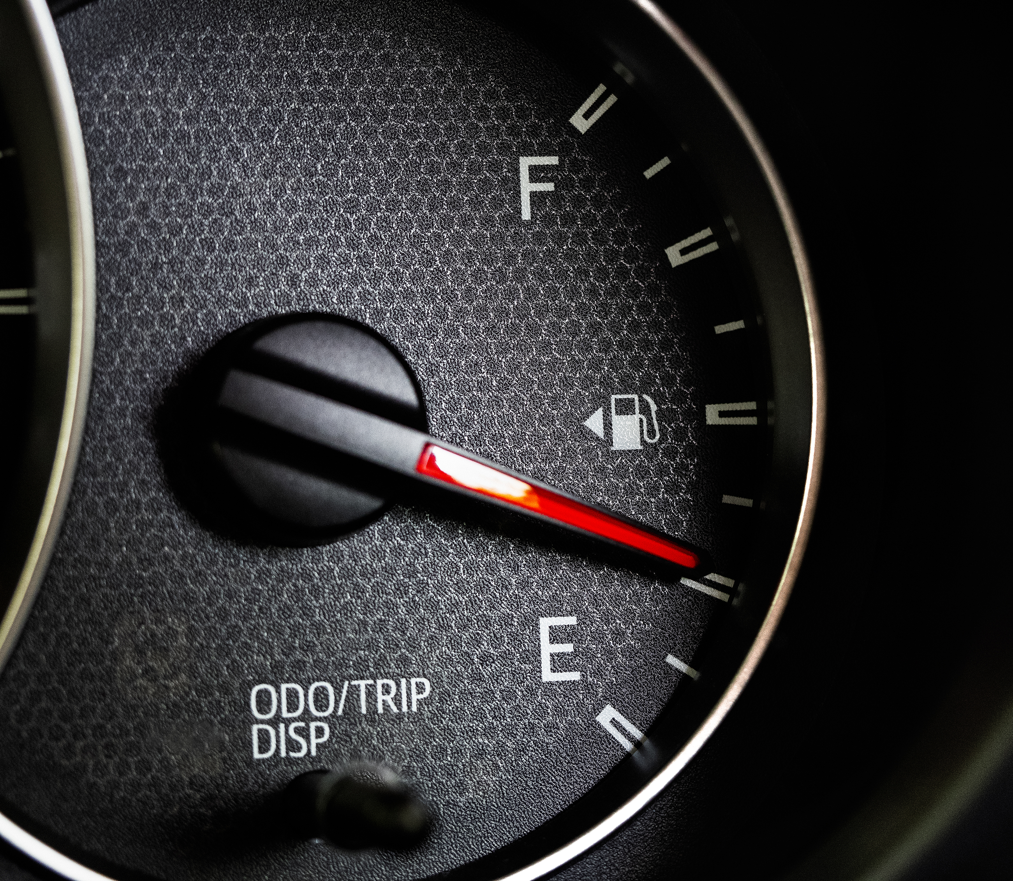
DATASET- AN INTRODUCTION
Derived from Kaggle, carprice.csv has 26 columns, 200+ rows and has information about make, model, features of the vehicle, price points, and multiple other aspects defining a vehicle. The output variable is the price of the car, input variables range from physical aspects of the car to functional aspects like horsepower, mileage, fuel efficiency etc.

Slide 4

RESEARCH QUESTIONS
-How do different factors such as year of production, make, model, features etc. affect the overall pricing of the car?
- Which factors are more important than others while determining the price?
PROBLEM STATEMENT
“ William Sonoma is opening a used car showroom across USA and wants to understand which variables should be taken into consideration when deciding the price point of each vehicle. He has hired a firm to model the price of cars based on various factors and figure out how they affect the overall cost of the car"

Slide 5
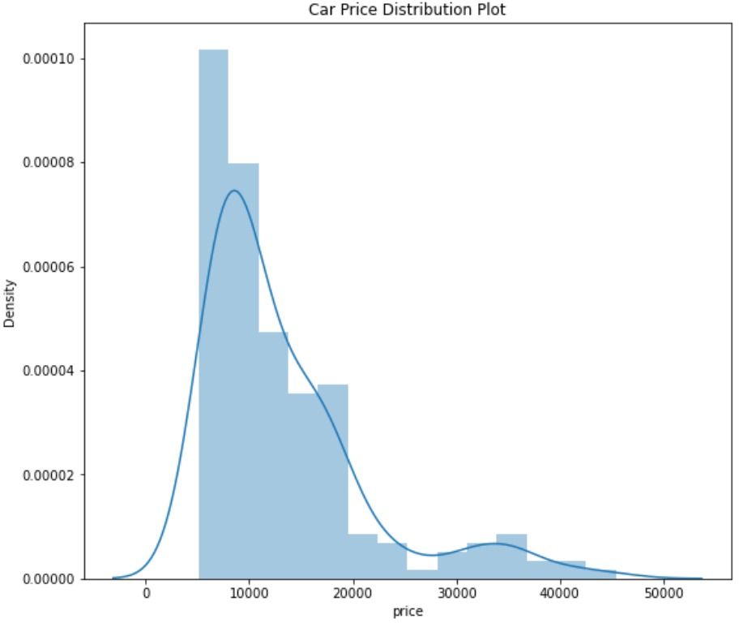
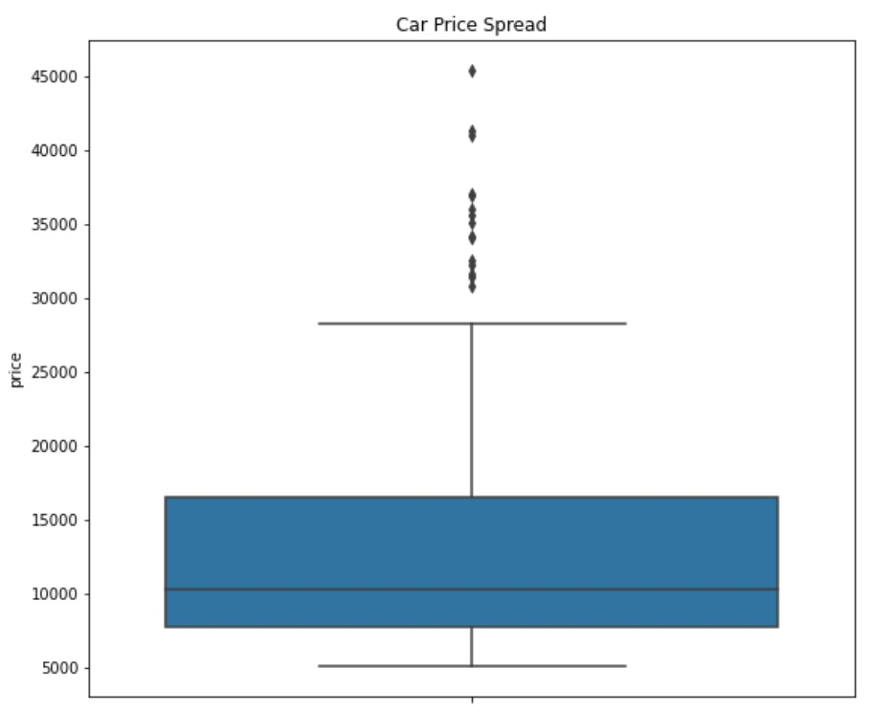
CAR PRICE DISTRIBUTION
Most prices lie in the range of $5000 to $20000 but there are quite a few outliers beyond $30000.

Slide 6
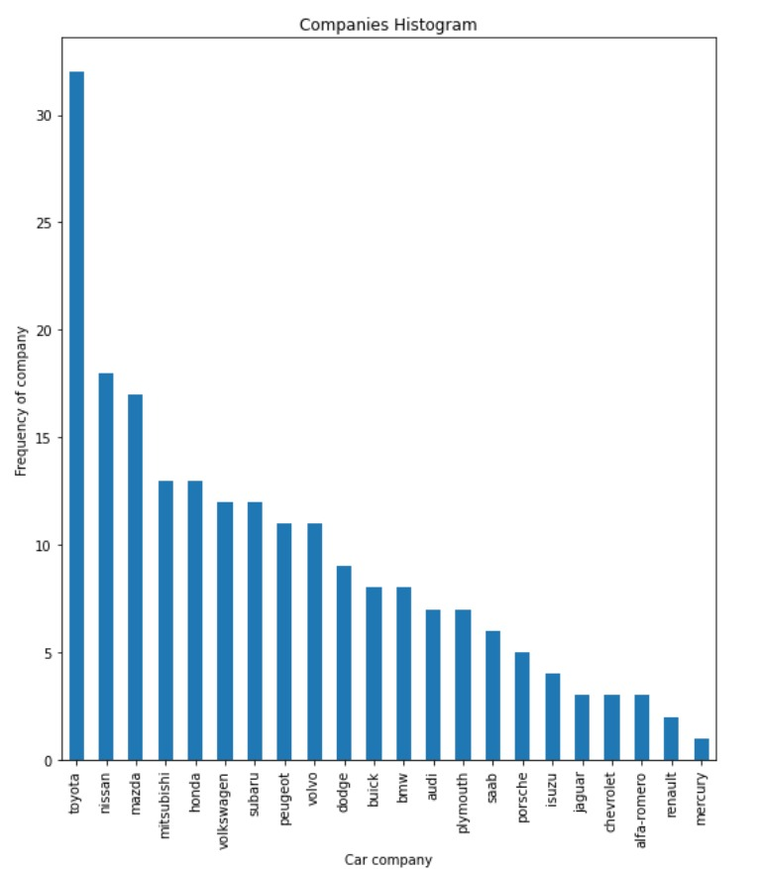
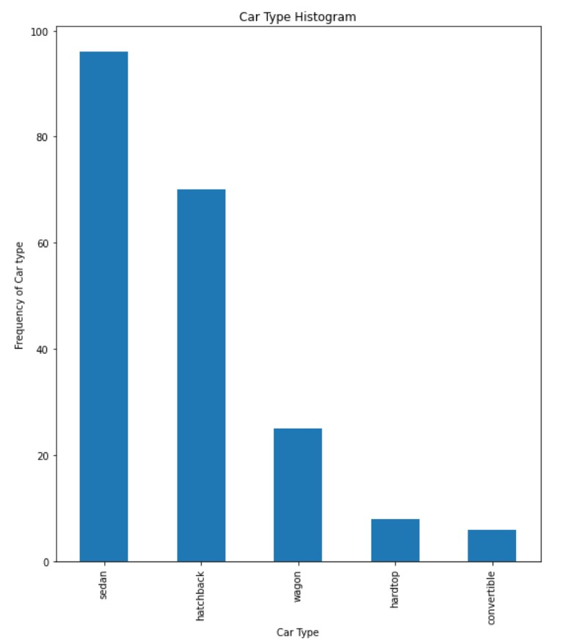
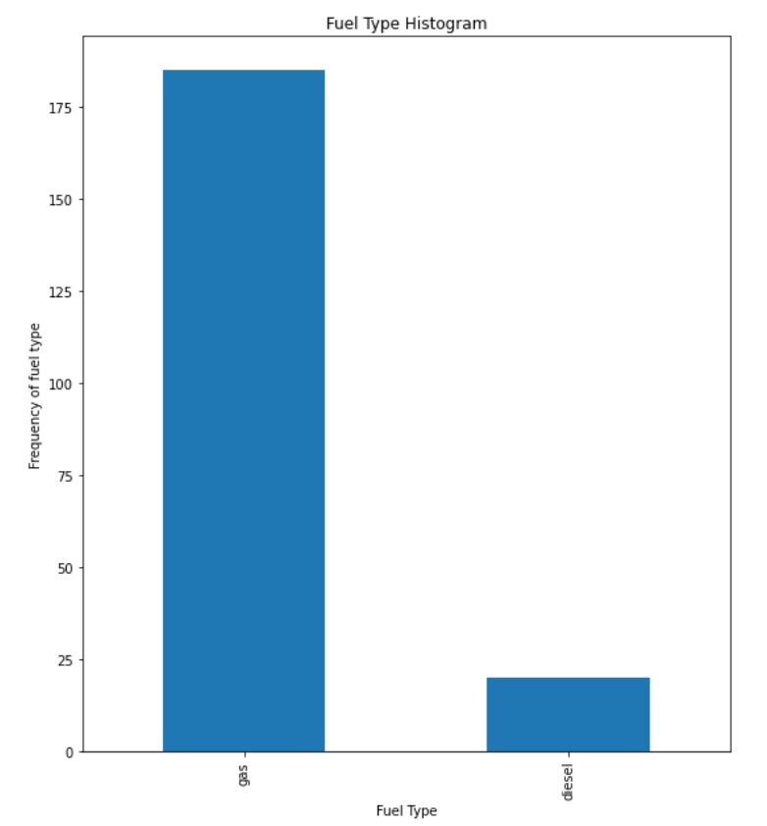
CAR MODEL, COMPANY, AND FUEL COMPARISONS
We can infer that Toyota is the most preferred company and sedan is the most preferred car type. Buyers mostly prefer gas over diesel when it comes to fuel

Slide 7
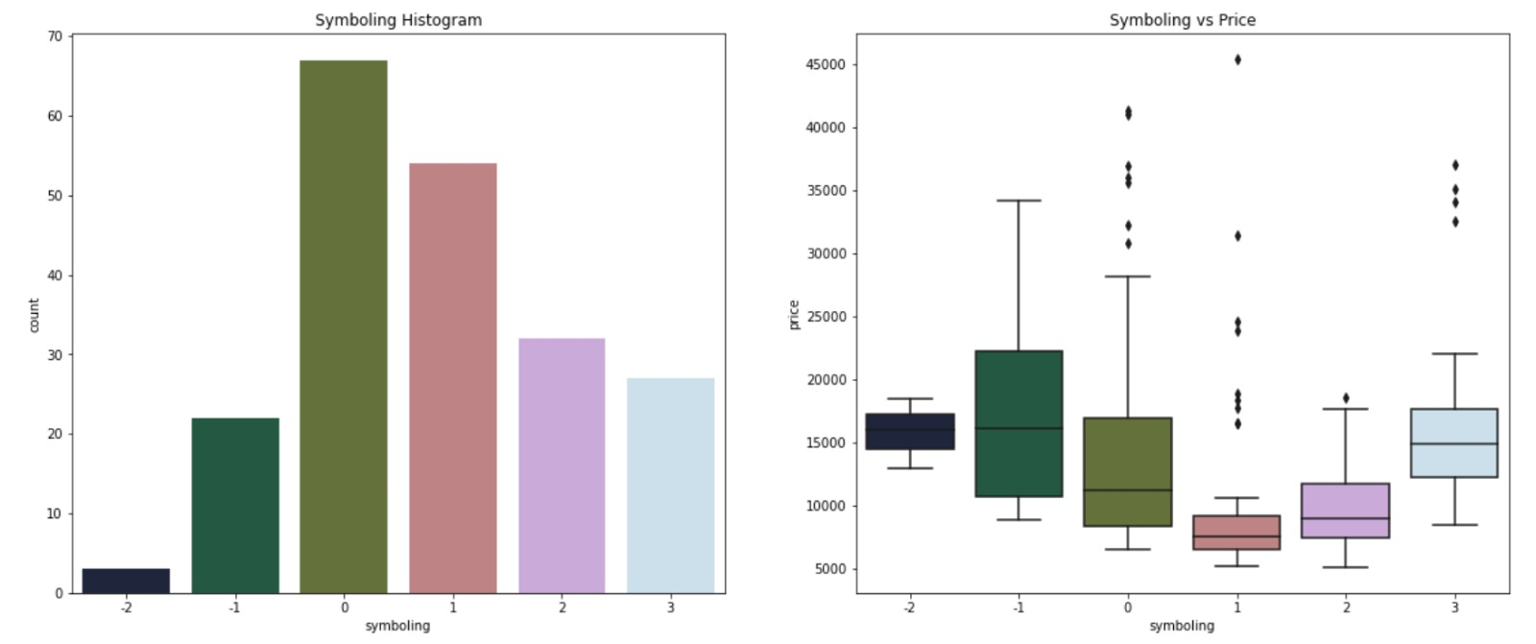
SYMBOLING AND PRICE COMPARISONS
Most cars range from 0 to 1 in terms of symbolling which means the cars used in this dataset are in average condition. Considerable number of cars have a positive score as well, which means their condition is below average.
Positive score in symbolling = below average to bad in terms of quality
Negative score in symbolling = Above average to good in terms of quality

Slide 8
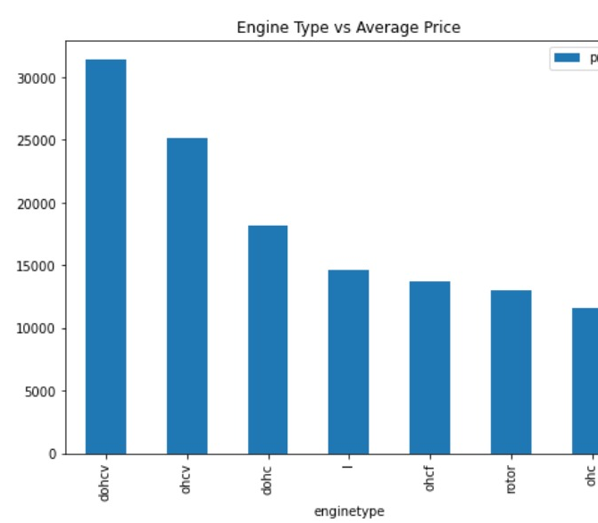
ENGINE TYPE VS AVERAGE PRICE
“dohcv” and “ohcv” engine types are engine types which mostly impact the price of the car. This could be because these engine types are generally more expensive

Slide 9
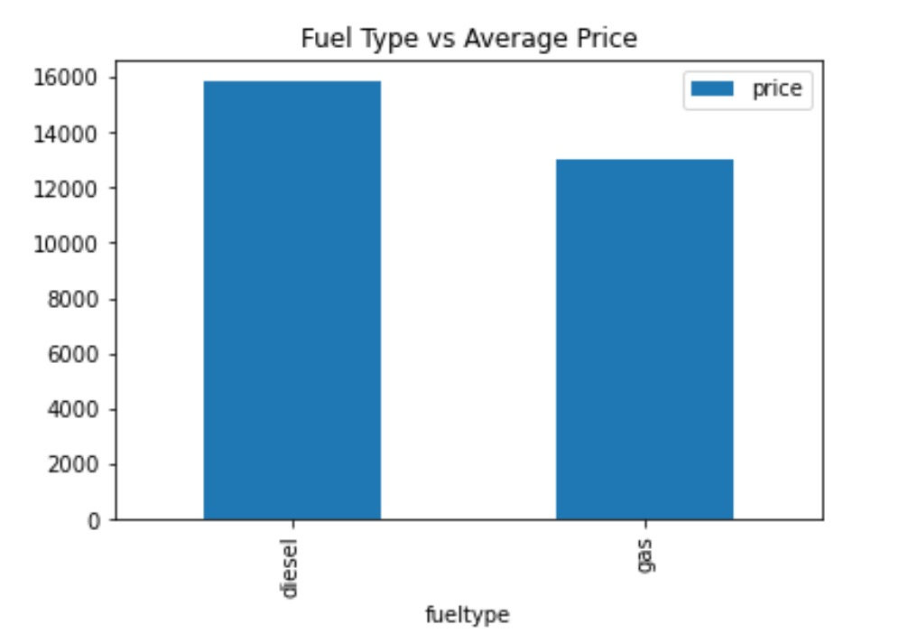
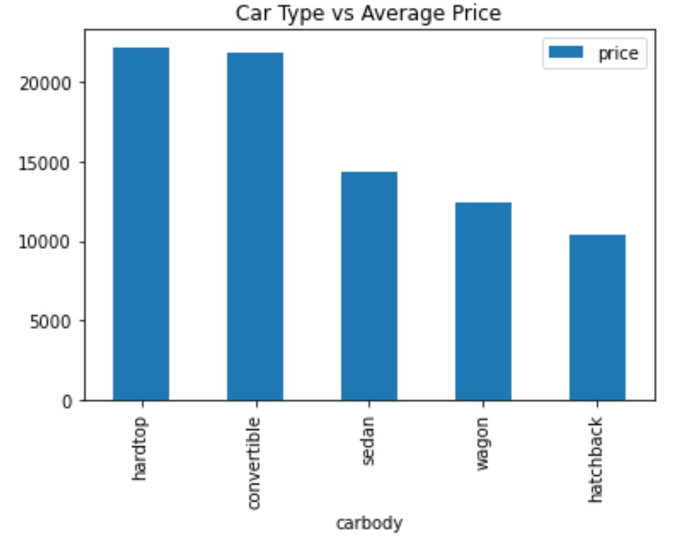
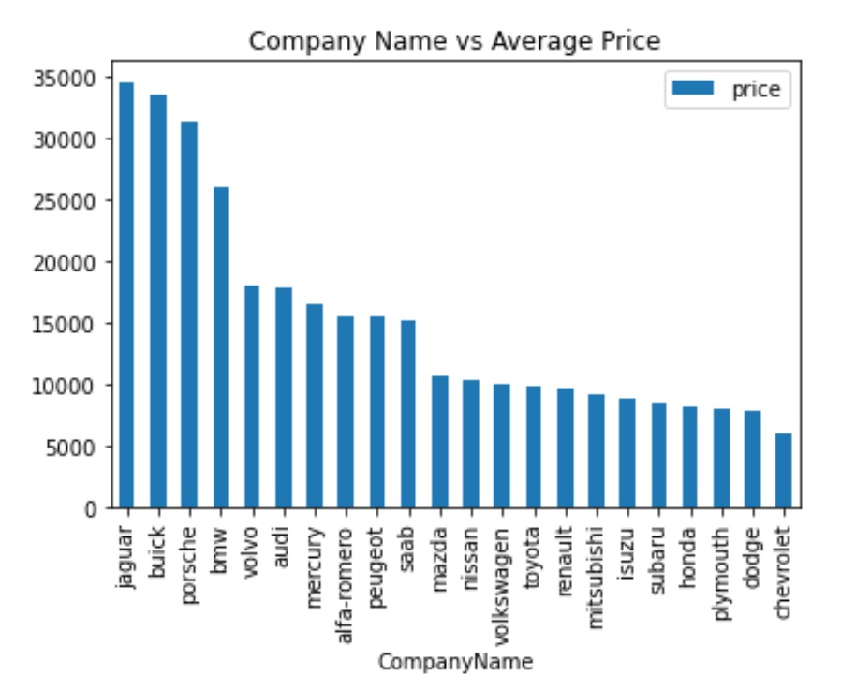
CAR COMPANY, CAR TYPE, AND FUEL TYPE VS AVERAGE PRICE
Because diesel cars are priced more than gas, people prefer cars that run on gas.
Moreover, convertibles and hard tops are priced more than sedan, wagon and hatchback so the former have lesser chance of getting sold and sedans are most preferred and highest selling cars

Slide 10
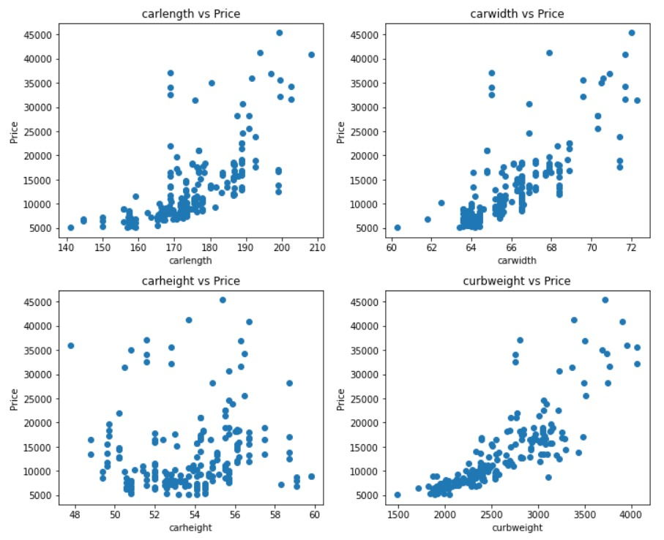
DIMENSIONS OF THE CAR VS PRICE
Length, width, and weight show a positive correlation but the points in height scatterplot are randomly distributed and don’t show a trend

Slide 11
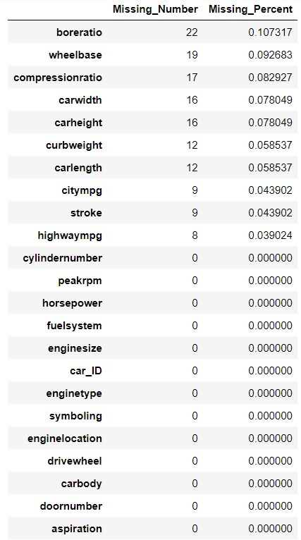
DATA PREPROCESSING
The process followed was –
CHECK FOR MISSING VALUES (boreratio, wheelbase, compressionratio, carwidth, carheight, curbweight, carlength, citympg, stroke and highwaympg have missing values
FIXED MISSING VALUES USING MEAN OF THE INDIVIDUAL RANGE (since missing values were numeric)

Slide 12
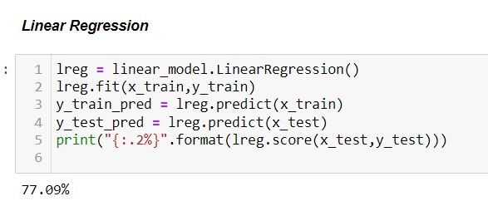
FITTING MODEL (LINEAR REGRESSION)
Linear regression involves understanding linear relationships and behavior between two variables, one being the dependent variable while the other one being the independent variable.
This model resulted in an accuracy of 77%. Therefore, it is a relatively decent fit to solve the problem

Slide 13
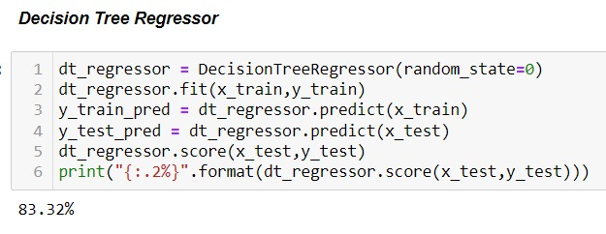
FITTING MODEL (DECISION TREE REGRESSOR)
This model uses a decision tree (as a predictive model) to go from observations about an item (represented in the branches) to conclusions about the item's target value
This model resulted in an accuracy of 83.32% and is a better fit for the intended solution

Slide 14
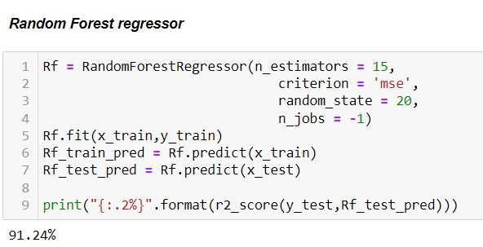
FITTING MODEL (RANDOM FOREST REGRESSOR)
This model utilizes ensemble learning, which is a technique that combines many classifiers to provide solutions to complex problems.
Key benefit of using RFC was that it can handle feature selection than another model.
Given the accuracy of 91.24% , we can say that random forest regressor is the best fit to predict the price of a car and solve our business problem

